Slide 1
Python-Class & Object
INT213

Slide 2
Introduction
Python has been an object-oriented language since it existed. Because of this, creating and using classes and objects are downright easy.
This chapter helps you become an expert in using Python's object-oriented programming support.

Slide 3
Overview of OOP Terminology
Class:A user-defined prototype for an object that defines a set of attributes that characterize any object of the class. The attributes are data members (class variables and instance variables) and methods, accessed via dot notation.
Class variable: A variable that is shared by all instances of a class. Class variables are defined within a class but outside any of the class's methods. Class variables are not used as frequently as instance variables are.
Instance variable: A variable that is defined inside a method and belongs only to the current instance of a class.
Data member: A class variable or instance variable that holds data associated with a class and its objects.
Instance: An individual object of a certain class. An object obj that belongs to a class Circle, for example, is an instance of the class Circle.
Instantiation: The creation of an instance of a class.
Method : A special kind of function that is defined in a class definition.
Object: A unique instance of a data structure that's defined by its class. An object comprises both data members (class variables and instance variables) and methods.

Slide 4
Overview of OOP Terminology
Inheritance: The transfer of the characteristics of a class to other classes that are derived from it.
Function overloading: The assignment of more than one behavior to a particular function. The operation performed varies by the types of objects or arguments involved.
Operator overloading: The assignment of more than one function to a particular operator.

Slide 5
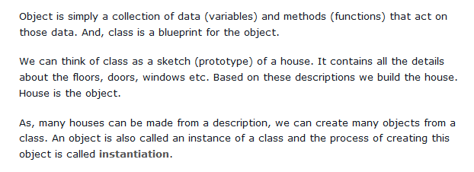
As soon as we define a class, a new class object is created with the same name. This class object allows us to access the different attributes as well as to instantiate new objects of that class.

Slide 6
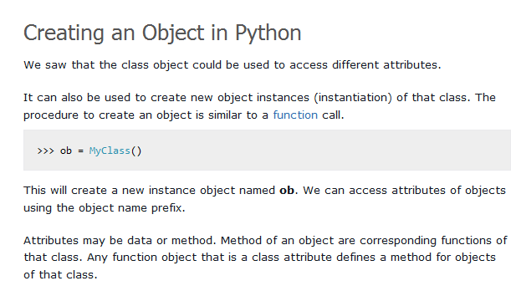

Slide 7
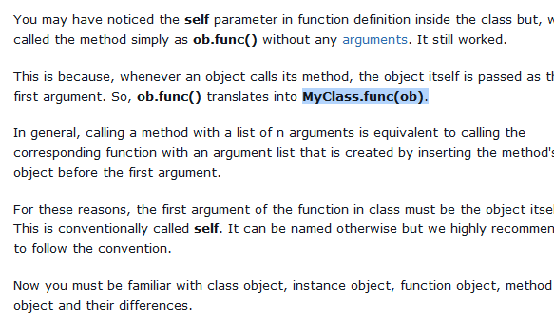

Slide 8
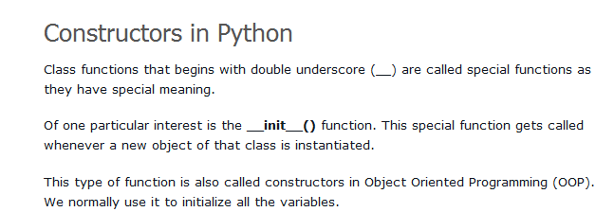

Slide 9
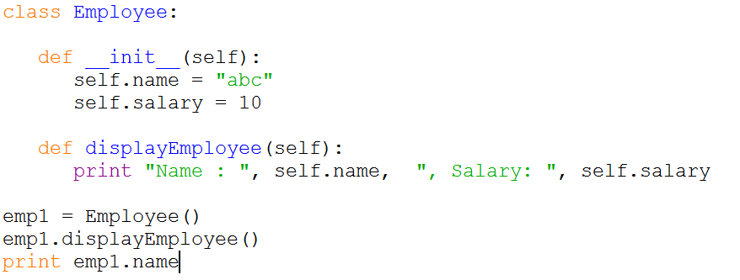
Example

Slide 10
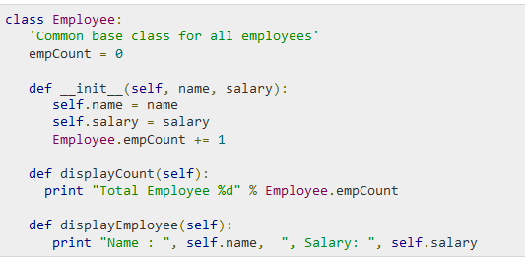
Creating Classes
The class statement creates a new class definition. The name of the class immediately follows the keyword class followed by a colon as follows −

Slide 11
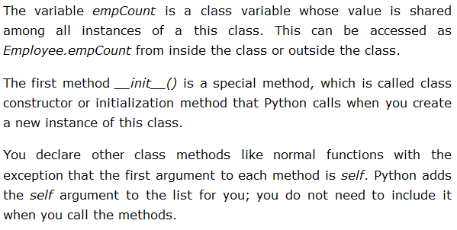

Slide 12
Creating Instance Objects
"This would create first object of Employee class"
emp1 = Employee("Zara", 2000)
"This would create second object of Employee class“
emp2 = Employee("Manni", 5000)

Slide 13
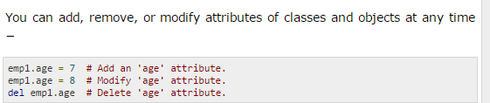
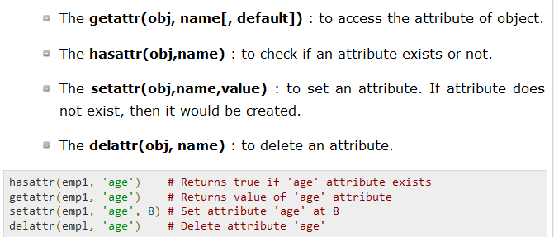
Accessing Attributes
emp1.displayEmployee()
emp2.displayEmployee()
print "Total Employee %d" % Employee.empCount

Slide 14
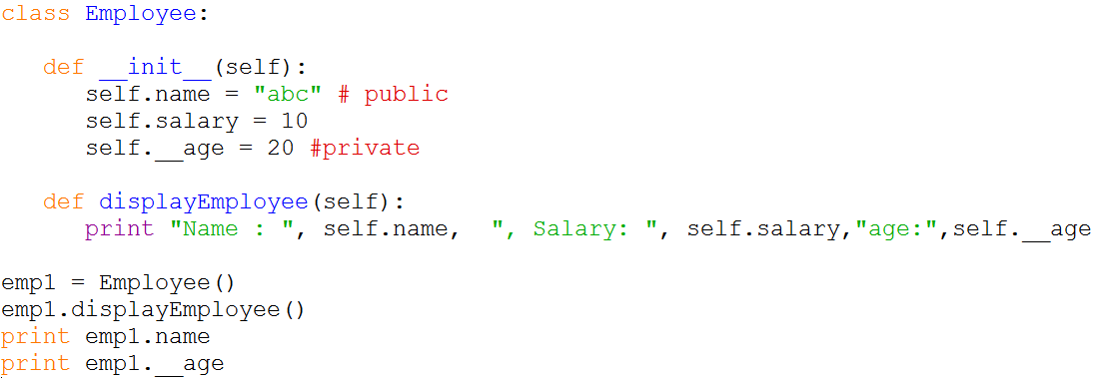
Public and private member in class

Slide 15
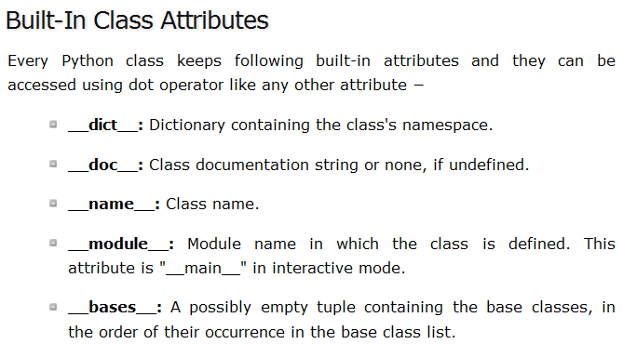

Slide 16
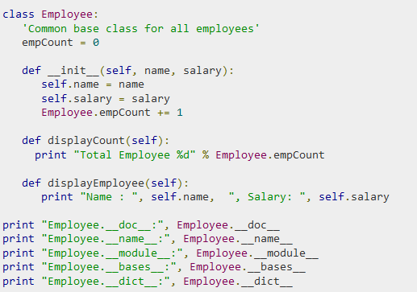

Slide 17
Destroying Objects (Garbage Collection)
Python deletes unneeded objects (built-in types or class instances) automatically to free the memory space.
The process by which Python periodically reclaims blocks of memory that no longer are in use is termed Garbage Collection.

Slide 18
Example
class Point:
def __init__( self, x=0, y=0):
self.x = x
self.y = y
def __del__(self):
class_name = self.__class__.__name__
print class_name, "destroyed"
pt1 = Point()
pt2 = pt1
pt3 = pt1
print id(pt1), id(pt2), id(pt3) # prints the ids of the obejcts
del pt1
del pt2
del pt3

Slide 19
We have a class defined for vehicles. Create two new vehicles called car1 and car2. Set car1 to be a red convertible worth $60,000 with a name of Fer, and car2 to be a blue van named Jump worth $10,000.

Slide 20


